Slide 1

DATA SCIENCE
10 WEEK PART TIME COURSE
Supercharged Decision Trees

Slide 2
AGENDA
Optimising decision trees

Slide 3
BIAS - VARIANCE TRADEOFF
Errors due to Bias
When we are training over multiple data sets we will have different errors. Bias measures how far off we are in general the predictions are from the actual values
Errors due to Variance
This is how variable our model is for a given data point. The variance calculates how much the predicted are from the actual values

Slide 4
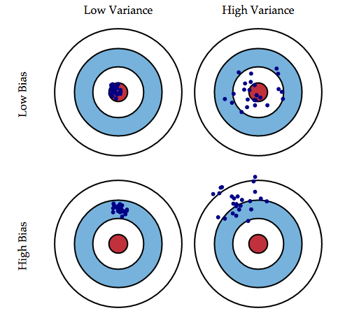
BIAS - VARIANCE TRADEOFF
4￼

Slide 5
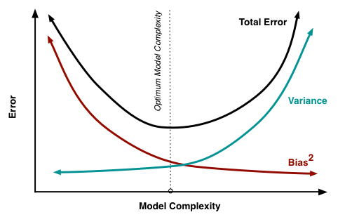
BIAS - VARIANCE TRADEOFF

Slide 6
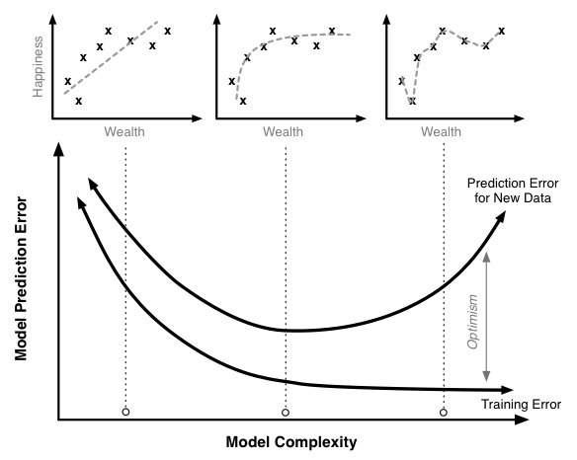
BIAS - VARIANCE TRADEOFF

Slide 7
GridSearchcv
GridSearchCV(ctree, param_grid, cv=5, scoring='roc_auc')

Slide 8
LAB
DATA SCIENCE PART TIME COURSE

